Slide 1
  Lesson6: Producer Pro Sync Import/Export Feature

Slide 2
Lesson 6: Producer Pro - Import/Export Feature
Export:-
Click on Export button from which interface you want to export from one environment to another.
Steps remain the same for any interface in Producer Pro
Step 1:
Click on this
Notes:
Its time to learn how to deploy code from lower to higher environments……Comes into action the Export/Import functionality Of ProducerPro.
Click on Export button from which interface you want to export from one environment to another.
Steps remain the same for any interface in Producer Pro.

Slide 3
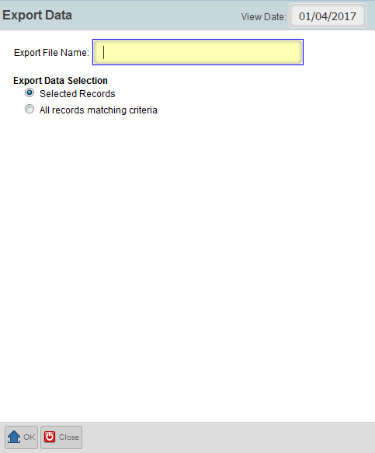
Lesson 6: Producer Pro - Import/Export Feature
Provide the file name to export
OK
Notes:
Provide the name (.zip) in which the export file needs to be saved and click on OK.

Slide 4
Lesson 6: Producer Pro - Import/Export Feature
Import:-
Click on Import button from which interface you want to import from one environment to another.
Steps remain the same for any interface in Producer Pro
Step 1:
Click on this
Notes:
Click on Import button from which interface you want to import from one environment to another.
Steps remain the same for any interface in Producer Pro.

Slide 5
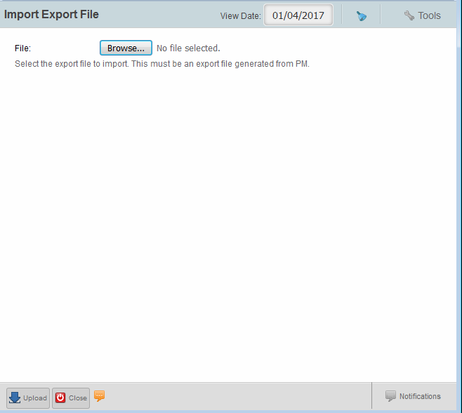
Lesson 6: Producer Pro - Import/Export Feature
Step 2:
Select the .zip file that you want to import (exported earlier) from one environment to another.
Click on Upload
Notes:
Browse for the filename which you have given while exporting (in slide 3).

Slide 6
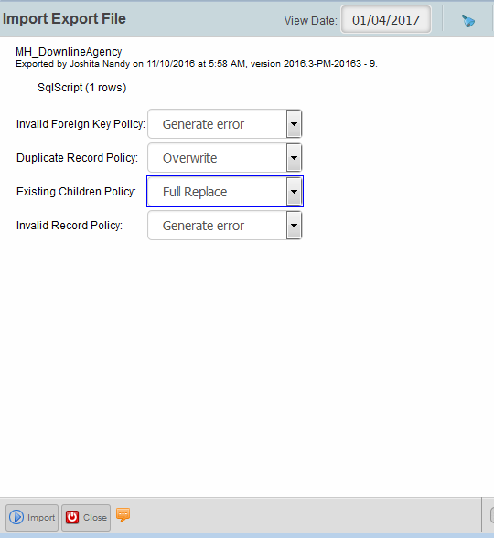
Lesson 6: Producer Pro - Import/Export Feature
Step 3:
Import
Notes:
The 4 options are mandatory to Import a file, as per import requirement, the conditions can be changed from the dropdown.
After clicking on “Import”, you will get a Success message(if load is successful) else error.
It is always recommended to check the Imported version even if it shows Success, since few instances show success but with no result.

Slide 7
Lesson 6: Producer Pro True Comp - Sync
The Producer Pro sync feature transfers a snapshot of data required for compensation from Producer Pro into Commissions (TrueComp) system. The document presents the details of configuration of this Product Feature.
Architecture
Notes:
The Producer Pro sync feature transfers a snapshot of data required for compensation from Producer Pro into Commissions (TrueComp) system. The document presents the details of configuration of this Product Feature.

Slide 8
Test Your Understanding
  Why do we need Producer to TC sync?
Notes:
Why do we need Producer to TC sync?
What is the functionality of export and import features?

Slide 9
Test Your Understanding
  Usage of export and import features?
Notes:
Why do we need Producer to TC sync?
What is the functionality of export and import features?

Slide 10

Summary
You should now be able to:
  Import/Export
  Sync
Notes:
You should now be able to import/export configuration file and sync pmpro data with tcmp.

